Slide 1




Presentation on
Intelligent Real-Time Street Parking Solutions - ParkHub
Guided By:
Prof. Pawan Kumar Gupta
Presented By:
Nikita Porwal(0827IT231095) Rajnandani Patidar(0827IT231109) Sidhant Narkhede(0827IT231133) Vishal Nakum (0827IT231147)

Slide 2
Contents
Introduction
Overview
Purpose
Problem Statement
System Features
System Architecture
Tech Stack
Home Page
User Dashboard
Admin Dashboard
Conclusion
REFERENCES

Slide 3
1. Introduction
Overview
As cities grow in population and the number of vehicles in India spikes, parking space has turned into a serious challenge for authorities and citizens, making the challenge multifaceted. On-street parking space is limited, and the continuous search for free parking spots creates traffic and environmental issues. The problem of user frustration gets compounded. The Smart Vehicle Parking App solves this problem and to monitor open parking spaces for users to reserve and access the parking facilities. enables parking lot administrators
Purpose
The primary goal of this project is to create a smart and easy-to-use parking management system that benefits both administrators and citizens.These are the following purposes:
For administrators, the objective is to manage parking lots efficiently, monitor occupancy, and earn revenue through optimal utilization of available space
For users, the objective is to offer an easy method to reserve, occupy, and vacate parking spaces without inconvenience..
By minimizing search time, managing congestion, and providing fair pricing, the project aims to make city parking more structured, transparent, and sustainable.

Slide 4
2. Problem Statement
Although several parking management solutions are available in Indian cities, most existing systems lack a simple, accessible, and user-centric digital platform for efficient parking management. Many solutions depend heavily on expensive physical infrastructure and provide limited convenience for end users.
The key limitations identified are:
Lack of a web-based platform for easy parking slot discovery and reservation.
Dependence on costly hardware and infrastructure-intensive implementations.
Absence of dynamic pricing mechanisms based on real-time parking demand.
Limited visibility of parking availability for users.
Lack of an intuitive dashboard for monitoring and managing parking operations.
These limitations result in inefficient parking space utilization, increased search time, traffic congestion, and poor user experience. The proposed ParkHub system aims to address these challenges through a web-based smart parking platform offering real-time availability tracking, online reservations, dynamic pricing, and comprehensive dashboards for users and administrators.

Slide 5
3. System Features
The proposed system, ParkHub, is a web-based smart parking management platform developed using the MERN Stack (MongoDB, Express.js, React.js, and Node.js). It enables users to easily find, reserve, and manage parking spaces while allowing administrators to monitor and control parking operations efficiently.
The platform will include the following features:
User Registration & Authentication: Secure signup, login, and profile management for users.
Real-Time Parking Availability: Display available and occupied parking slots across different parking locations.
Parking Slot Reservation: Allow users to search, select, and reserve parking spots in advance.
Parking Session Management: Enable users to occupy and release parking slots while automatically tracking parking duration.
Booking History: Maintain records of previous bookings, parking duration, and parking charges.

Slide 6
System Features
6.Admin Dashboard: Provide administrators with facilities to create, update, and manage parking lots and parking spaces.
7.Search & Filter Features: Allow quick searching of parking lots, parking slots, and booking information.
8.Analytics & Reports: Generate visual reports showing occupancy status, parking utilization, and booking trends.
9.Responsive User Interface: Ensure seamless access across desktops, tablets, and mobile devices.
10.Secure Data Management: Implement role-based access control and secure storage of user and booking information.
11.Scalable Architecture: Support future enhancements such as online payments, GPS-based navigation, and smart-city integrations.
12.Payment Gateway Integration: Supports secure online payments for parking bookings and automatic transaction tracking

Slide 7
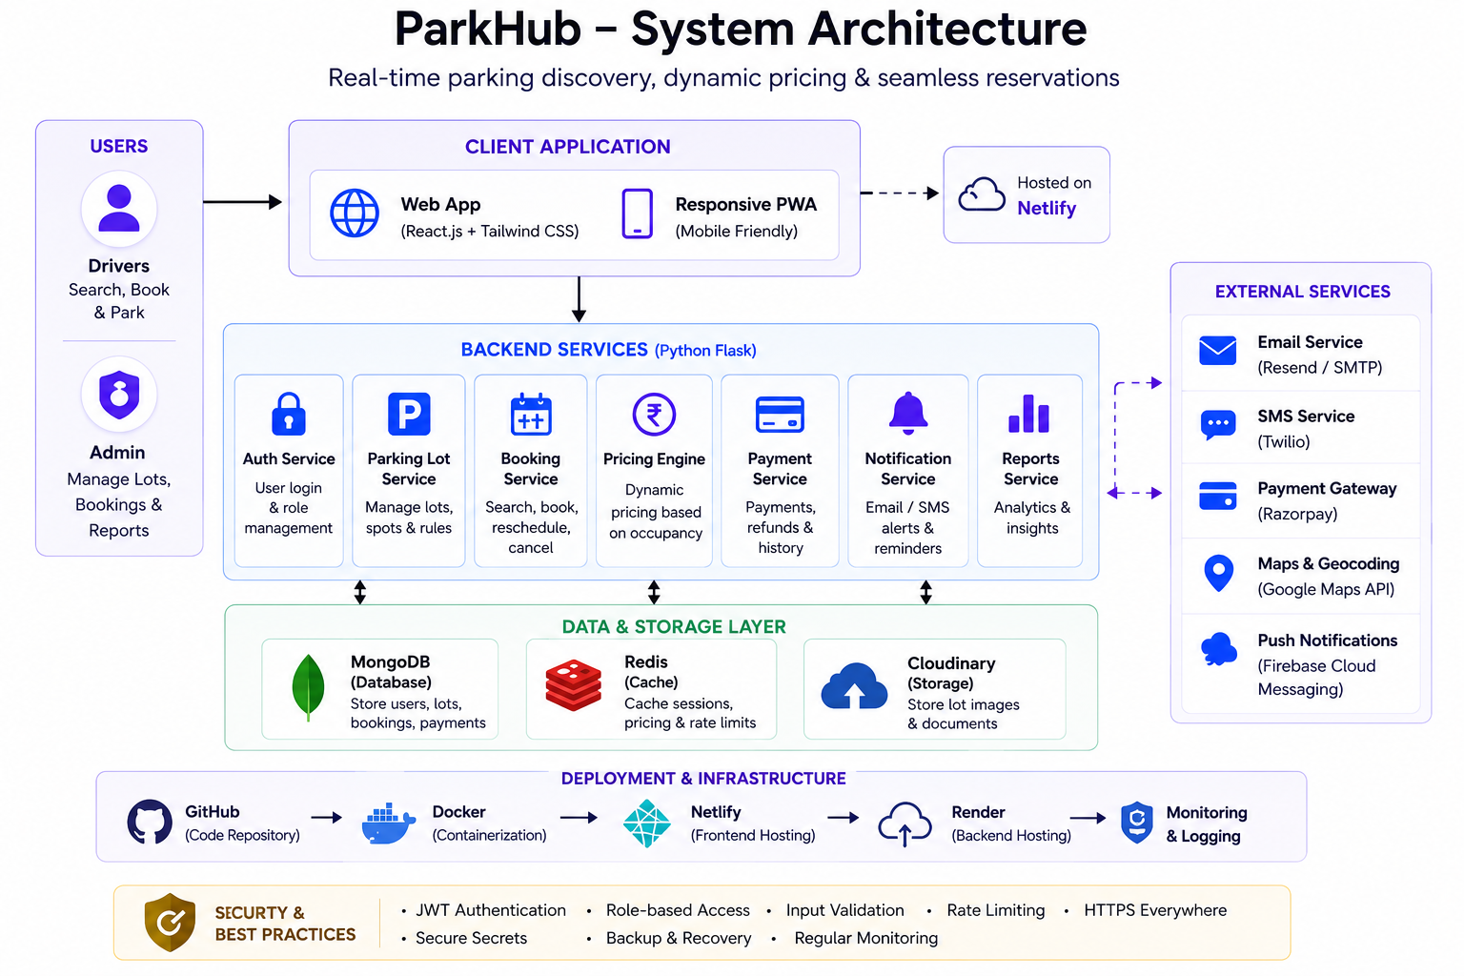
5. System Architecture

Slide 8
ParkHub is a web-based smart parking management system designed to provide real-time parking discovery, slot reservation, and occupancy monitoring. The system follows a three-tier architecture consisting of the Presentation Layer, Application Layer, and Data Layer.
The Frontend Layer is developed using React.js and Tailwind CSS, providing an interactive interface for users and administrators. Users can search for parking lots, reserve slots, and view booking history, while administrators can manage parking lots, bookings, and system reports.
The Backend Layer is built using Node.js and Express.js, which handle authentication, parking lot management, booking operations, dynamic pricing calculations, and analytics generation. This layer processes user requests and enforces business logic.
The Database Layer uses MongoDB to store user information, parking lot details, parking spot availability, booking records, and activity logs. It ensures efficient data retrieval and real-time updates.
The architecture enables secure communication between components, supports dynamic pricing based on occupancy levels, and provides real-time parking availability, resulting in an efficient and scalable parking management solution.

Slide 9







6. TECH STACK
6.3 Software Requirements
Category | Requirement & Purpose
Frontend | React.js: Dynamic, responsive pages HTML5, CSS3, JS: Structure, styling, interactivity
Backend | Node.js + Express: Server-side logic, APIs, request handling
Database | MongoDB: Store users, parking lots, parking spots, bookings, and activity logs
Authentication | JWT / OAuth: Secure authentication and password encryption
Development Tools | VS Code: Code editor Git / GitHub: Version control & collaboration Postman: API testing & debugging
Hosting / Deployment | Netlify (Frontend) & Render (Backend): Application deployment and hosting
Browser Support | Chrome, Edge, Firefox: Ensure compatibility across major browsers
11

Slide 10
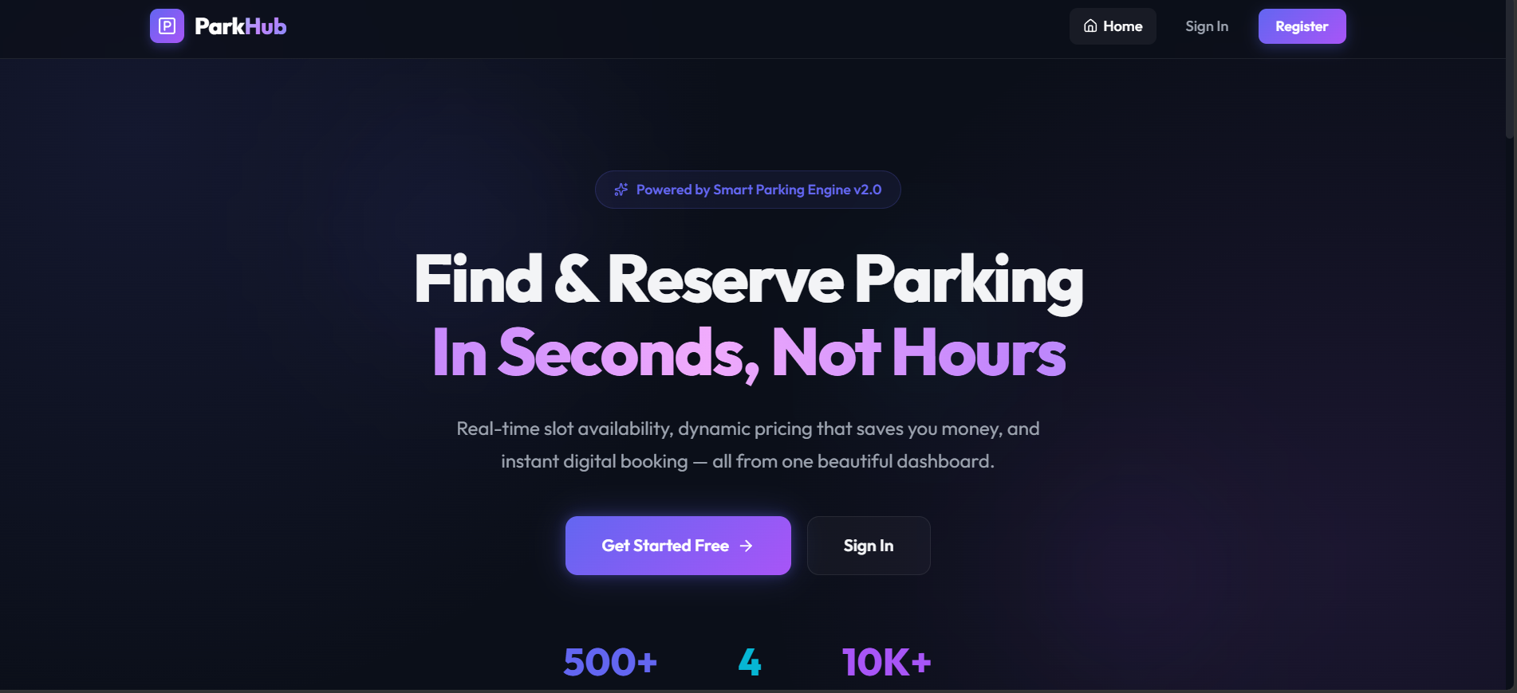
7.Home Page

Slide 11
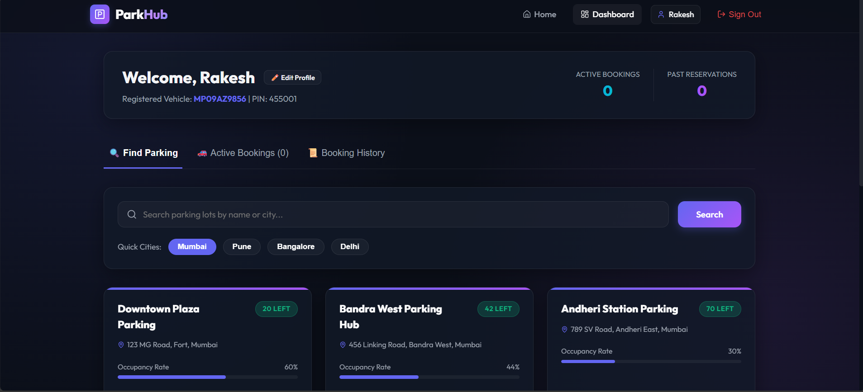
8.USER DASHBOARD

Slide 12
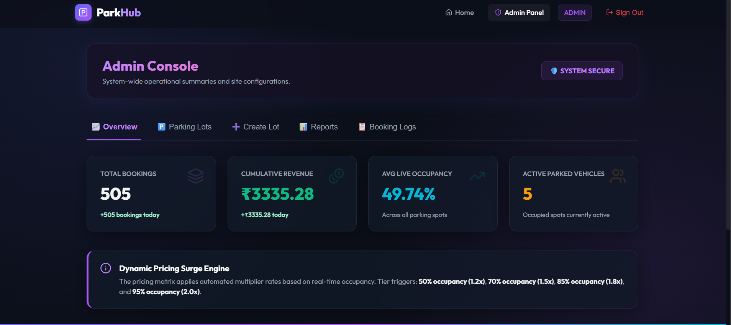
9.Admin Dashboard

Slide 13
10.Conclusion
ParkHub provides a smart, efficient, and user-friendly solution for parking management.
The system enables real-time parking availability tracking, online reservations, dynamic pricing, and secure payments.
It reduces parking search time, improves parking space utilization, and minimizes traffic congestion.
The Admin Dashboard facilitates effective monitoring and management of parking operations.
Built using the MERN stack, the platform is scalable, secure, and capable of supporting future smart-city integrations.

Slide 14
REFERENCES
[1]. Smart Mobility Today, “How Indian Cities Are Tackling the Urban Parking
https://www.smartmobilitytoday.in/urban-parking
Crisis,” Jan. 2026.
[2]. Urban Tech Insights, “Dynamic Pricing Models in Smart Parking Systems,” Whitepaper,Sept.2022,Available: https://www.urbantechinsights.com/reports/smart-parking-pricing
[3]. Parking Network, “Global Trends in Web-Based Parking Solutions,” Industry Blog,Dec 2021. https://www.parkingnetwork.com/blog/web-based-solutions
[4]. City Data India, “Case Study: NDMC Smart Parking Initiative in New Delhi,” Available:
https://www.citydataindia.org/reports/ndmc-parking
[5]. Tech4Urban, “User-Centric Design in Smart Parking Platforms,” Technology Blog, Oct,2022. https://www.tech4urban.in/blog/user-centric-parking

Slide 15
Queries ?

